Slide 1
Impact of Ocean Acidification on Routine Metabolic Rate and Critical Partial Oxygen Pressure of Muusoctopus leioderma

Slide 2
Introduction
The ability of organisms to utilize calcite and aragonite exceedingly decreases as the ocean acidification rate increases.
Dissolution of existing calcite and aragonite structures also is present with increased acidity.
Decreased pH can affect the respiratory pigments of octopuses.
Impaired respiratory pigments lead to less oxygen for metabolic processes.
A quick acclimatization to a low pH was observed by Dr. Onthank and Trueblood in Octopus rubescens (Onthank et al., 2021).

Slide 3
Research Questions
How does the routine metabolic rate of Muusoctopus leioderma change in high versus ambient pCO₂?
How does the critical partial oxygen pressure, an indicator of how well an organism functions under hypoxic stress, of Muusoctopus leioderma change in high versus ambient pCO₂?

Slide 4


Matthew Gano, Nathaniel Iwakoshi, and Kyle Moss

Slide 5
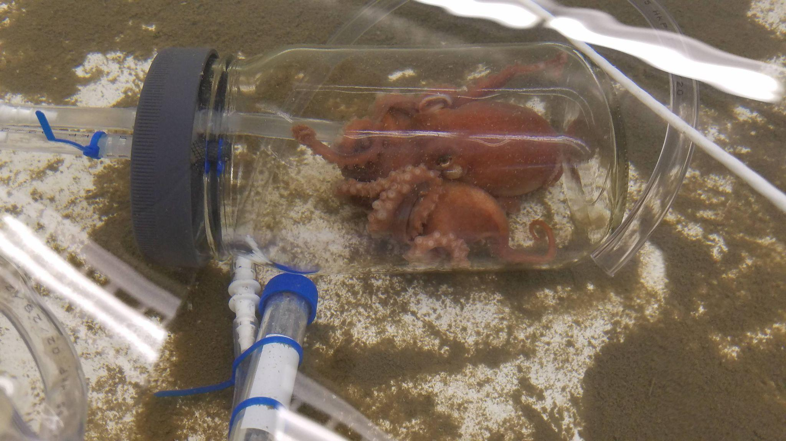
Figure 1. Muusoctopus leioderma during flow through respiratormetery to determine routine metabolic rate (RMR).

Slide 6
Methods
Collection of Muusoctopus leioderma (N = 12) by SCUBA between 10-15m in Burrows Bay, Skagit County, Washington.
Octopuses were placed in treatment tanks with either a pCO₂ of 1,000 µatm or a pCO₂ of 1,800 µatm to simulate current and future ocean acidification conditions.
pH was measured daily by spectrophotometry and alkalinity was measured once per week by alkalinity titration and these data points were used to calculate and adjust the treatment tank pCO₂ as needed.
Routine metabolic rate (RMR) and critical partial oxygen pressure (pCrit) was measured at 24 hours and then after 7 days in treatment by flow through and closed respirometry respectively (figure 1).
Statistical analysis was performed using R version 4.0.3 with the package RStudio.

Slide 7
A two way ANOVA and Tukey Test was done to compare the RMR at 1 and 7 days to the pCO2 levels. In addition, these tests were run on the pCrit data to compare the pCrit at 1 and 7 days to the pCO2 levels.

Slide 8
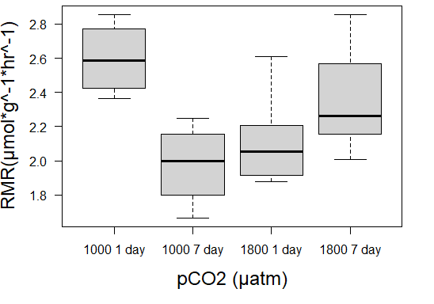
Figure 2. The median routine metabolic rate (RMR) of Muusoctopus leioderma after 1 day and after 7 days in either 1000 or 1800 µatm pCO₂ treatments.

Slide 9
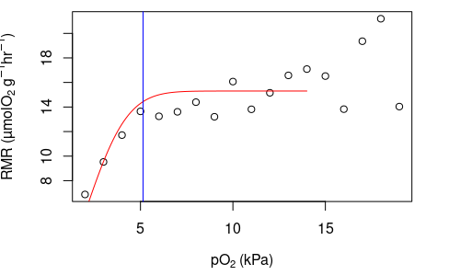
Figure 3. An example of the graph used to calculate critical partial oxygen pressure (pCrit). The red line is the oxygen consumption, and the blue line marks the pCrit value.

Slide 10
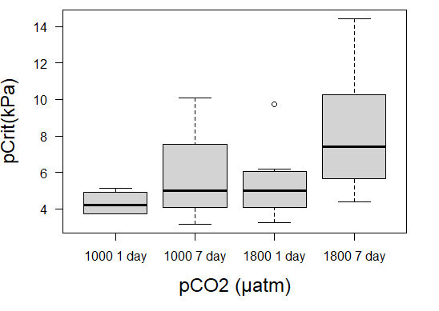
Figure 4. The median critical partial oxygen pressure (pCrit) of Muusoctopus leioderma after 1 day and after 7 days in either 1000 or 1800 µatm pCO₂ treatments.

Slide 11
Results
When testing for differences with an two way ANOVA, one significant p-value (p = 0.00163) for RMR was found, p-values for pCrit were all insignificant.
A Tukey test for RMR determined that there were significant differences. First, between the 1000 day 1 and 1800 day 1 (p=0.0426415). Second, a difference was found between 1000 day 1 and 1000 day 7 (p=0.0193662).
Parametric tests were used with nonparametric data because they are more robust.

Slide 12
Discussion
What possible physiological mechanisms generate this response in Muusoctopus leioderma?
One possible reason for this increase in RMR may be a result of hypercapnia (Onthank et al., 2021).
Is it possible that Muusoctopus leioderma would be able to acclimate to the high pCO₂ ?
Does this shallow water population of Muusoctopus leioderma differ from deeper populations in its ability to handle pH stress?

Slide 13
Conclusion
Muusoctopus leioderma increased its RMR in response to an elevation in carbon dioxide levels, but it decreased in response to lower carbon dioxide levels.

Slide 14
Acknowledgements
We would like to thank the divers who collected the octopuses: Dr. Lloyd Trueblood, Dr. Kirt Onthank, Dr. Alan Verde, Jefferson Humbert, and Phoebe Churney.
We are especially thankful for Dr. Lloyd Trueblood for his inspiration, donuts, and late night dives for octopuses, Dr. Erin Banks-Kirkham for her paper guillotine, Dr. David Cowes for his color printer, and to Dr. Kirt Onthank for his assistance with the painful Rstudio.

Slide 15
References
Onthank, K. L., Trueblood, L. A., Taylir Schrock-Duff, & Kore, L. G. (2021).
Impact of short- and long-term exposure to elevated seawater pco2 on
metabolic rate and hypoxia tolerance in octopus rubescens. Physiological
and Biochemical Zoology, 94(1), 1-11. https://doi.org/10.1086/712207.

